Slide 1
OpenVPN

Slide 2
General
Initial release 13 March 2017 by James Yonan
Open source / freeware
Virtual private network
  p2p connection between client and server
device independent
Notes:
p2p = point to point

Slide 3
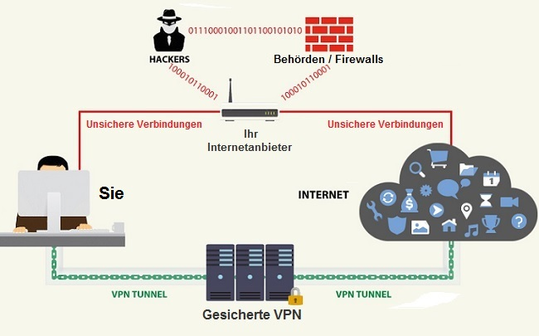
Features / Advantages
encrypts your data
-> increased security
-> prevents traffic block
Notes:
Encrypts data
Prevents block thorugh Internet Service Provider

Slide 4
Encryption / Decryption
OpenSSL Encryption
  initial release 23 December 1998
  256 Bit Encryption
works with UDP and TCP
save authentification
  pre-shared keys
  passwords
  certificates
Notes:
Udp = user datagram protocol
Tcp = transmission control protocol
UDP/TCP = Internet protocol used to send data through networks

Slide 5
Quellen
www.vpnoverview.com
www.openvpn.net
https://en.wikipedia.org/wiki/OpenVPN

